Slide 1
F2F Meeting 24-07-24
Week 10 of 20

Slide 2
Last meeting…
Lab presentation, updated everyone in the group on my project.
Laid out a plan/timeline for the next few of weeks
Next steps were to complete the annotation step ✅
Proceed with downstream analysis this week ⌛

Slide 3
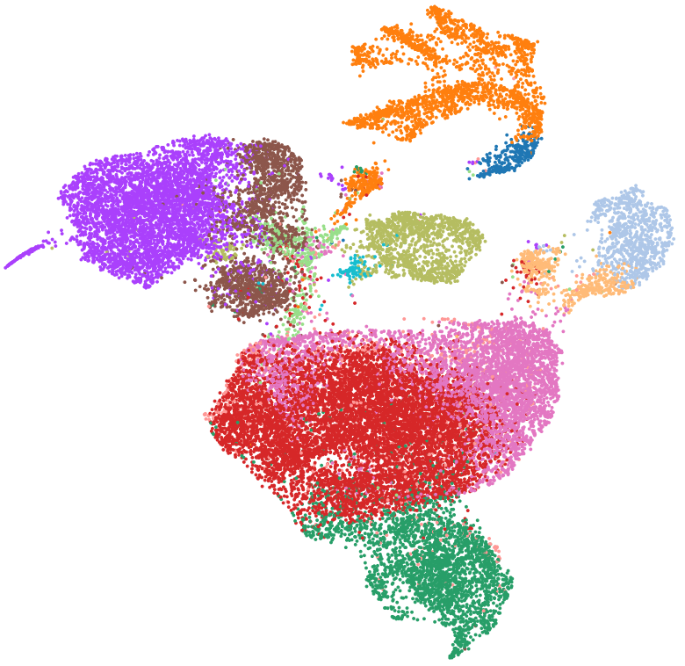
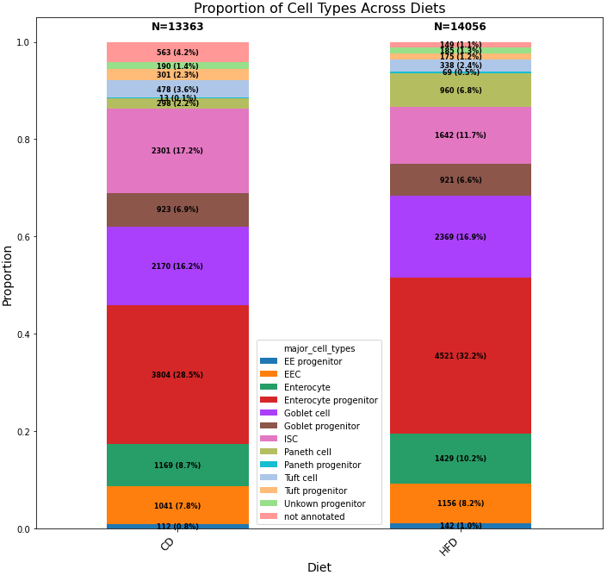
Annotated Crypt Enriched Dataset

Slide 4
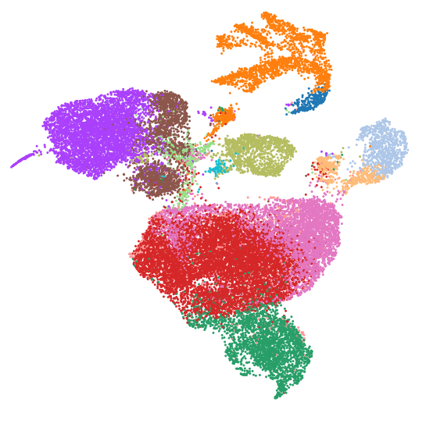
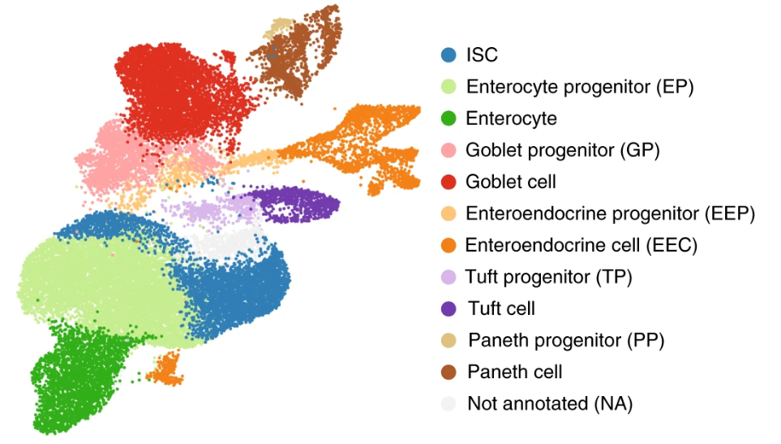
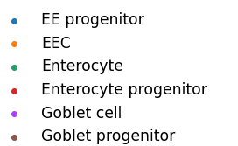
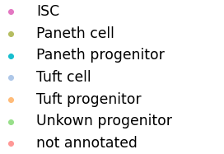
Crypt Enriched Dataset - Side-by-side comparison

Slide 5
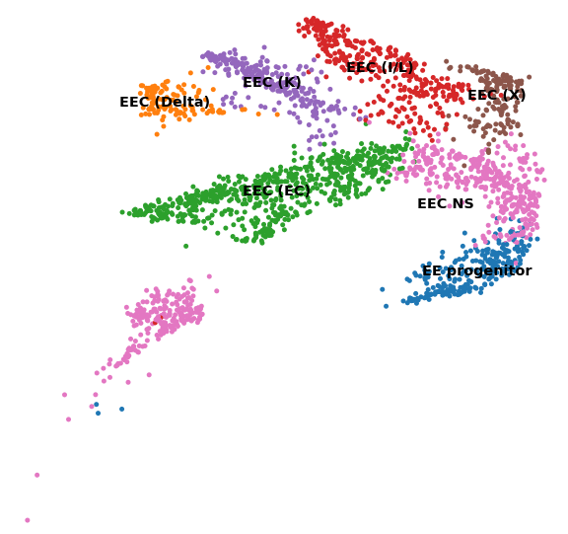
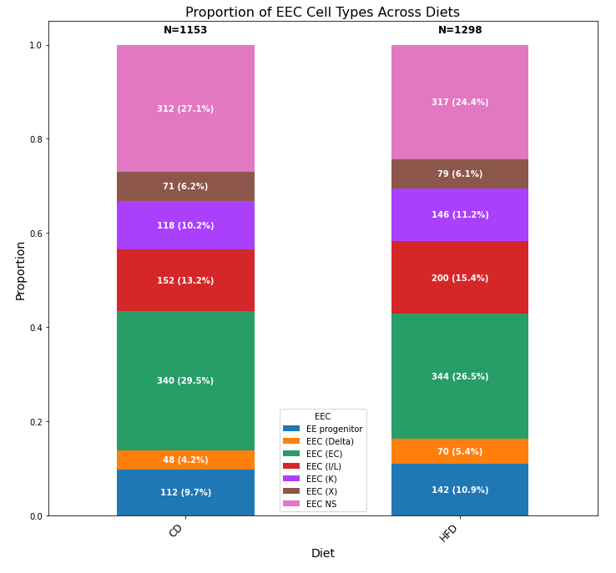
Crypt Enriched - EEC Clusters

Slide 6
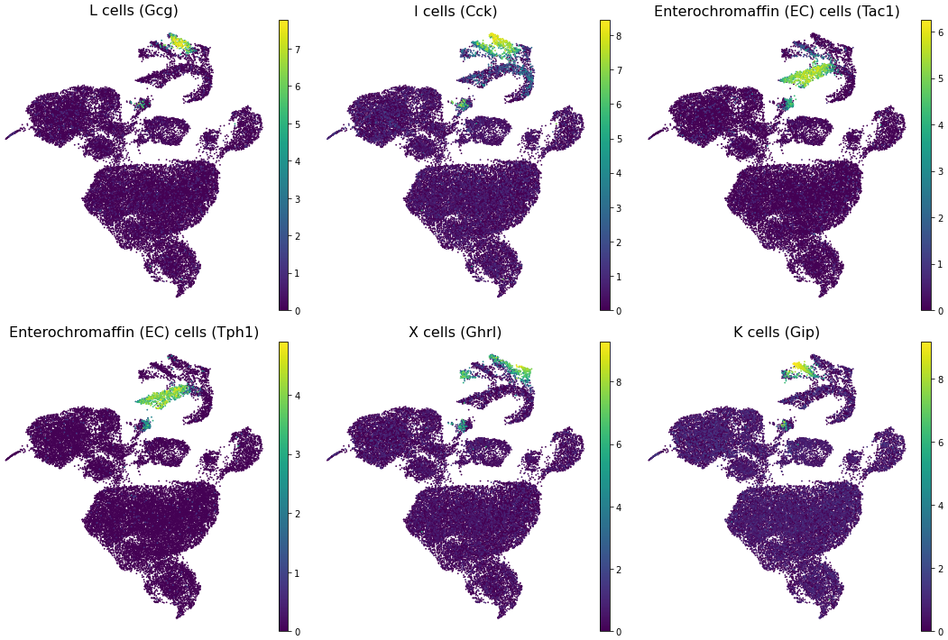
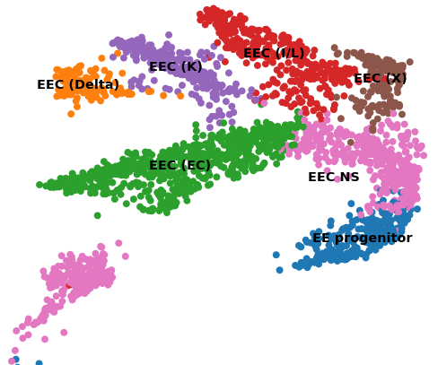
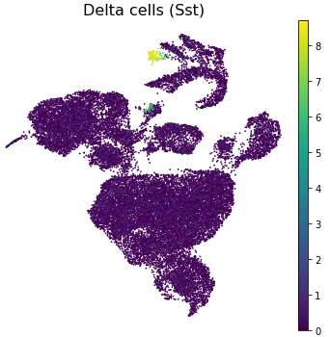
Crypt Enriched - EEC Marker Gene Expression levels
Expression levels of selected EEC markers across EEC clusters plotted in UMAP space

Slide 7
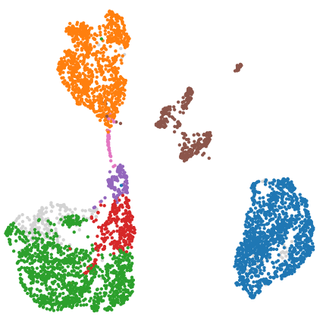
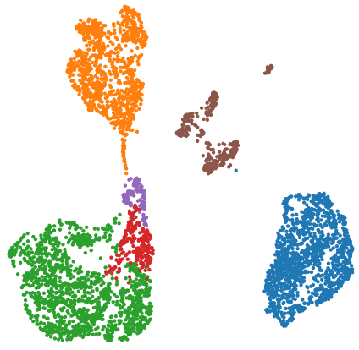
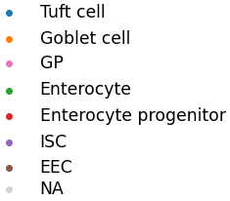
Annotated Villus Isolate Dataset
My Annotation (From Scratch)
Published annotations mapped to my UMAP

Slide 8
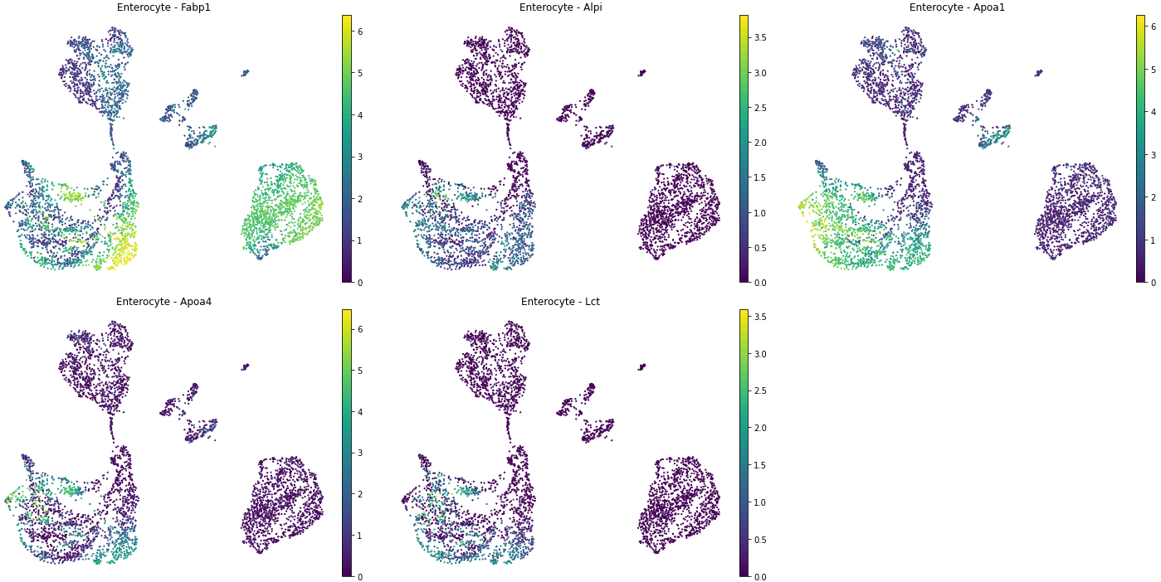
Villus Isolate - Enterocyte Marker Gene Expression levels
Expression levels of Enterocyte markers plotted in UMAP space

Slide 9
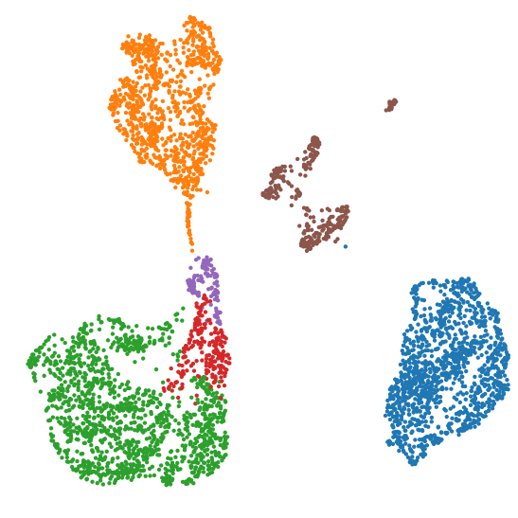
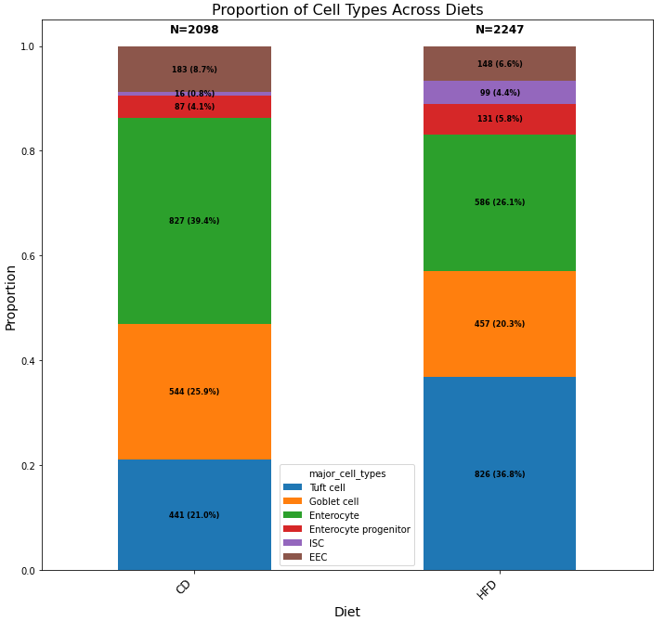
Villus Isolate Dataset

Slide 10
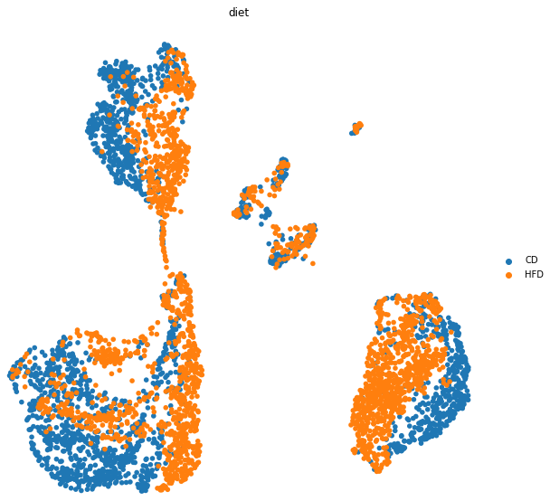
Villus Isolate Dataset
Goblet
EEC
ISC
Ent. Prog.
Tuft
Enterocytes

Slide 11
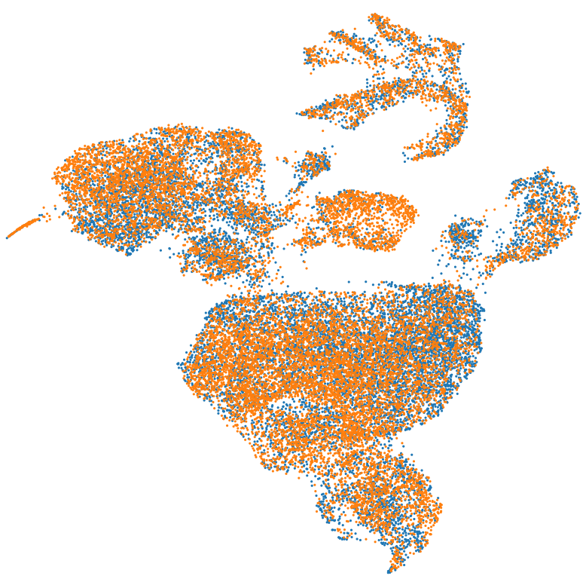
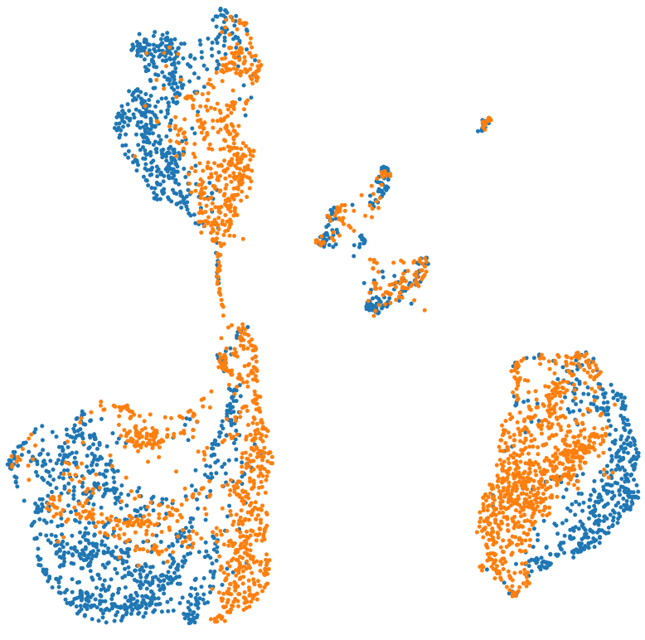
Are these differences due to batch effect or diet?
Crypt Enriched (Batch Corrected Across all 6 samples)
Villus Isolate (Not Batch Corrected)

Slide 12
Questions To Answer
Should the crypt enriched dataset be batch corrected across all 6 samples, or batch corrected across the 3 CD samples and 3 HFD samples separately.
OR
Should the villus isolate dataset be batch corrected across the two samples.

Slide 13
Are we on track?
Complete Cell Annotation
15 July 2024 - 21 July 2024
Form Biological Hypothesis
Review the data
29 July 2024 - 16 August 2024
✅
Run Data Through Pipeline
ISC, Paneth Cell, Enterocytes
22 July 2024 - 28 July 2024
Produce First Draft
16 August 2024 - 16 September 2024
⌛

Slide 14
Next steps
Email authors about batch correction question.
Contact other experts about it too.
Input the results from this weeks annotation into the current downstream pipeline focussing on ISC, enterocytes and paneth cells.

